Slide 1
Environmental Statistics with R
Chris Jochem
20 April 2020

Slide 2
Online learning
Suggestions for our meetings:
Keep your microphone muted unless you are speaking
Wave or get my attention, or put a note in chat if you want to speak
Use the chat and messaging functions – ask (and answer) questions
Follow along with the demo. I will pause regularly for questions and to catch up
This is an experiment for most of us!
Constructive feedback is welcome: What works and what does not?

Slide 3
Quantitative methods sessions
R and RStudio (23 March)
Introduction to Environmental Statistics with R (20 April [Today])
Course materials: http://www.github.com/wcjochem/R_training
Potential other sessions (Not yet scheduled. Email Chris if interested)
Designing and analysing survey samples
Data visualisation using ggplot and other R tools
Spatial regression and spatial analysis with R
Advanced R programming (functions, loops, big data)

Slide 4
Additional learning resources for using R software
Stat-545 [online class materials]: https://stat545.com/index.html
Hands-On Programming with R [book]: https://rstudio-education.github.io/hopr/
Advanced R [book]: http://adv-r.had.co.nz/Introduction.html
R Inferno [book]: https://www.burns-stat.com/pages/Tutor/R_inferno.pdf
Spatial data in R: https://www.r-spatial.org/
RStudio cheat sheets: https://rstudio.com/resources/cheatsheets/
RStudio: https://github.com/rstudio/cheatsheets/raw/master/rstudio-ide.pdf
Base R: http://github.com/rstudio/cheatsheets/raw/master/base-r.pdf
Advanced R: https://www.rstudio.com/wp-content/uploads/2016/02/advancedR.pdf

Slide 5
Today’s Topics
Working with a dataset – data input/output, cleaning, manipulation
Basic spatial data handling and more practice with scripts and good data management
Introduction to statistical concepts, tools in R for performing these calculations, and where to find more resources
Principal components analysis (PCA)
Spatial autocorrelation
Time series models

Slide 6
Learning objectives
By the end of this lesson, you will be able to:
Load/read vector and raster datasets
Run a principal components analysis, producing plots of variance and a biplot
Calculate a Moran’s I statistic on spatial data to examine residuals
Gain experience with two, basic time series models and the building block functions of forecasting

Slide 7
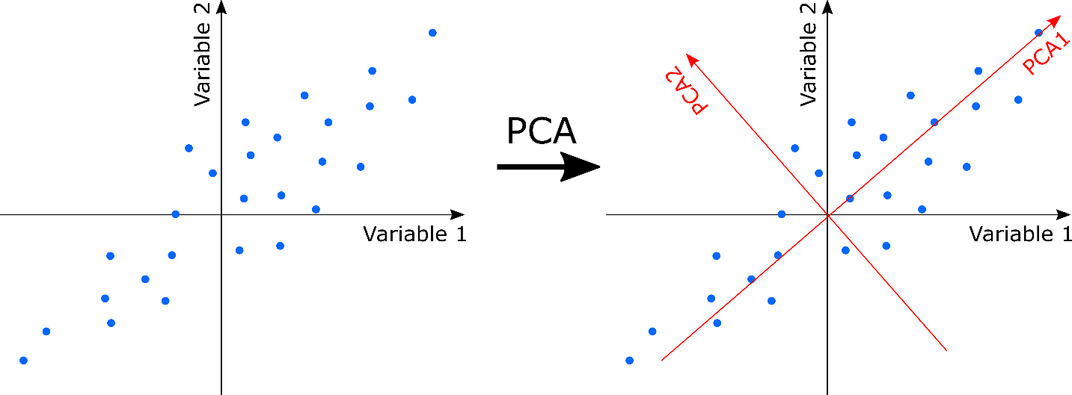
Principal Components Analysis (PCA)
Start with multiple measurements or variables for each observation and convert them to a new “coordinate system” with axes that represent a combination of variables
Teases out the most variation by reducing redundant or correlated data
Can highlight patterns of similar observations, underlying gradients, and help predict or group new observations
https://ourcodingclub.github.io/tutorials/ordination/

Slide 8
Principal Components Analysis (PCA)
PCA is sensitive to the scale of the variables.
Centre/Scale them (subtract the mean and divide by the standard deviation)
Does not (generally) work well for categorical variables (omit or use other methods)
May not work well when you have few observations and lots of variables
Can make it more difficult to interpret your variables
The components and factors may not be clearly related or easy to explain
Watch out for the “horseshoe effect” caused by an assumption of linearity

Slide 9
Principal Components Analysis (PCA)
What should you report in a paper?
The variables that were included and whether they were centred and scaled
How many components were selected to be used in further analyses
The cumulative variation explained by the selected components.
Consider including a screeplot of explained variance
Consider showing the factor loadings for the selected components in a supplementary table

Slide 10
Other Resources on Principal Components Analysis
Worked Examples
http://ecology.msu.montana.edu/labdsv/R/labs/lab7/lab7.html
https://ourcodingclub.github.io/tutorials/ordination/
Other Analysis Packages
Vegan: https://cran.r-project.org/web/packages/vegan/index.html
Factoextra: https://cran.r-project.org/web/packages/factoextra/index.html
Deep Dives
https://setosa.io/ev/principal-component-analysis/
https://royalsocietypublishing.org/doi/10.1098/rsta.2015.0202

Slide 11
Correlation – how observations are related
Many statistical tests make an assumption that observations are independent
But observations which are “closer” tend to be more similar…
Closer is a relative term and it could be defined in space and/or in time
Autocorrelation or Spatial Autocorrelation are the terms used to describe this with correlation being related to time or to distance between observations
Statistically, spatial and temporal autocorrelation share a lot of similarities

Slide 12
Spatial autocorrelation
Is it a problem? It depends! (See the debate among ecologists)
Not necessarily bad (and often expected) in natural phenomena
Temperature, rainfall, elevation all exhibit spatial patterns which then result in spatially-patterned outcomes like species distributions, abundances, etc.
Can be a problem when the results of regression models are spatially correlated
Models assume independence of observations (sp. autocorrelation says they’re not)
Correlated residuals can cause standard errors to be biased downward
Can be very informative! It can point towards an underlying or unidentified factor driving a process, or it can help to make predictions when a model is incomplete.
Results from biologically interesting processes, like dispersal. The scale at which things are correlated can be informative for that process, too.

Slide 13

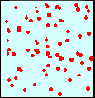
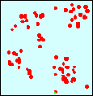
Moran’s I Statistic
Global spatial autocorrelation measures
Identifies if the data as a whole exhibit a spatial pattern
Value ranges from -1 (regular) to 0 (random) to +1 (clustered)
Null Hypothesis: No Spatial Autocorrelation
Spatial randomness
values observed at a location do not depend on values observed at neighboring locations
observed spatial pattern of values is equally likely as any other spatial pattern
the location of values may be altered without affecting the information content of the data
Regular
Random
Aggregated

Slide 14
The calculation of the global Moran’s I statistic requires the calculation of “neighbour” weights

Slide 15
Resources on Spatial Autocorrelation
Summaries of the debate in Ecology
https://dynamicecology.wordpress.com/2013/10/02/autocorrelation-friend-or-foe/
https://theoreticalecology.wordpress.com/2012/05/12/spatial-autocorrelation-in-statistical-models-friend-or-foe/
https://gwenantell.com/analyses-for-spatial-autocorrelation/
Deep dives into methods and models
Dormann, C. et al. (2007). “Methods to account for spatial autocorrelation in the analysis of species distributional data: a review.” Ecography, 30(5):609-628.
https://onlinelibrary.wiley.com/doi/full/10.1111/j.2007.0906-7590.05171.x
Getis, A. 2008. “A History of the Concept of Spatial Autocorrelation: A Geographer’s Perspective.” Geographical Analysis 40:297-309. https://onlinelibrary.wiley.com/doi/full/10.1111/j.1538-4632.2008.00727.x

Slide 16
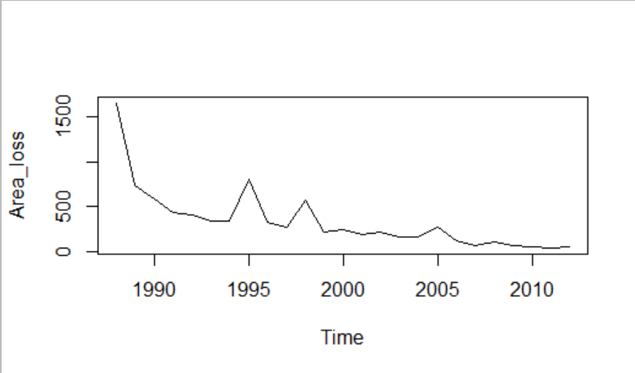
Time series modelling
Given a set of repeating observations over time producing a sequence
Often the goal is to forecast future events
Autocorrelation or Autoregression means that previous events are related and can help predict future values
Can take a regression approach
Or model based on the idea:
Structure = Trend + Cycle + Season + Error
Potentially with explanatory variables in the model

Slide 17
Time series common modelling approaches
Exponential smoothing
Uses weighted averages of past observations to forecast
Can incorporate trend and seasonality components
Model selection guided by information criteria (e.g. AIC)
Auto-regressive integrated moving-average models (ARIMA)
Describing and using the autocorrelation in the dataset
Depend on stationarity in the data
Main components are (P, D, Q): autoregressive terms, differencing levels, moving-average or smoothing terms

Slide 18
Resources on Time Series Models
Textbook: Forecasting Principles and Practice: https://otexts.com/fpp2/
Recent resources in R: https://blog.revolutionanalytics.com/2020/04/forecasting-best-practices-from-microsoft.html
Good introductions and walk-throughs using R:
http://environmentalcomputing.net/forecasting-time-series/
https://www.southampton.ac.uk/~mb1a10/stats/FEEG6017_lecture-Time_series_analysis.pdf
Example data sets for more practice on time series
https://pkg.yangzhuoranyang.com/tsdl/articles/tsdl.html

